Slide 1
Ibm DateScience Professional Certificate _ Capstone
Travel agency consultant (Best Place in Rome)

Slide 2
Introduction
Rome (Latin and Italian: Roma) is the capital city and a special comune of Italy). Rome also serves as the capital of the Lazio region. With 2,872,800 residents in 1,285 km2 (496.1 sq mi).It is the fourth most populous city in the European Union by population within city limits. It is the centre of the Metropolitan City of Rome, which has a population of 4,355,725 residents, thus making it the most populous metropolitan city in Italy.Rome is located in the central-western portion of the Italian Peninsula, within Lazio (Latium), along the shores of the Tiber. The Vatican City (the smallest country in the world)is an independent country inside the city boundaries of Rome, the only existing example of a country within a city: for this reason Rome has been often defined as capital of two states.

Slide 3
Business Problem
From consulting companies we are required by a group of tour operators to provide some well-defined program that allows these tourist agencies to create a series of tourist packages to be provided to their customers, in particular we are required to provide specific information about:
Historycal place to visit
Restaurant for typical food
Good accomodation Hotel
Spa and Wealth center

Slide 4
Data 4 Analysis
The information will be extrapolated mainly from 3 sources:
Foursquare api
Wikipedia source
Edited csv.dataframe

Slide 5
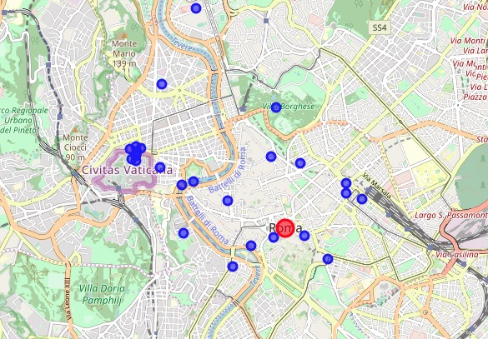
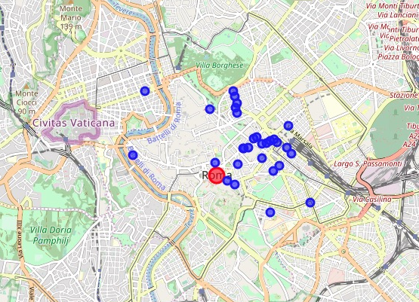
First impression visual rappresentation
The Foursquare API allow us to get a clear rappresentation of the place location in the center of Rome (as show below picture)
MUSEUM
HOTEL

Slide 6
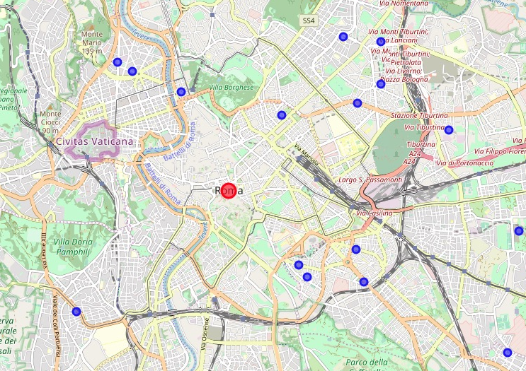
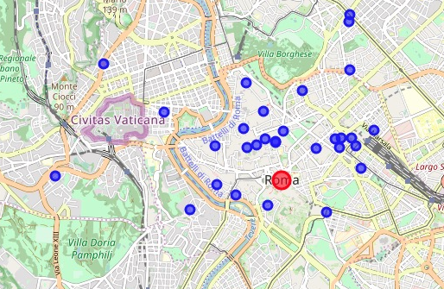
First impression visual rappresentation
The Foursquare API allow us to get a clear rappresentation of the place location in the center of Rome (as show below picture)
SPA
RESTAURANT

Slide 7
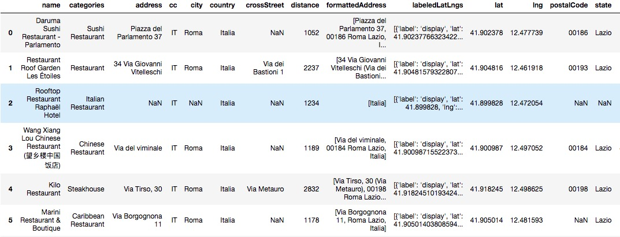
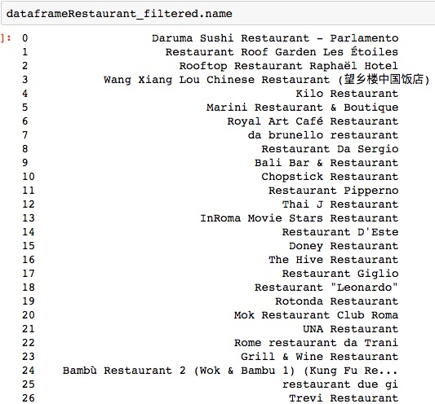
Classification of Venues (example)

Slide 8
Conclusion
This work is a simple example of what can be done by combining data from different sources and with different algorithm.
Serves as a starting point for further analysis. For example, using additional time, create personalized paths that take into account the distances between the places of interest and the time needed to visit them, optimizing timetables and routes,as well as classify the places of interest according to the visitors' opinions.

Slide 9
THANKS

